Slide 1
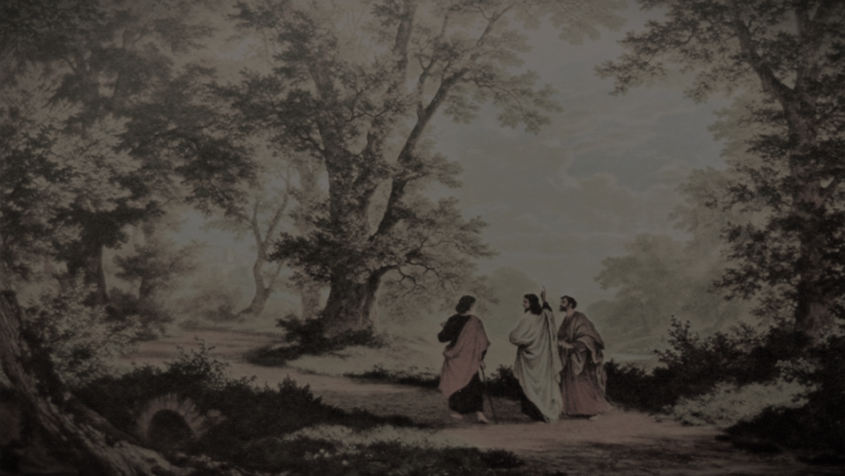
Just One Word

Slide 2
MATTHEW 5 : 17 - 22
. . . no jot or tittle shall pass . . .

Slide 3
REVELATION 22 : 18 - 19
. . . do not add or take away . . .

Slide 4
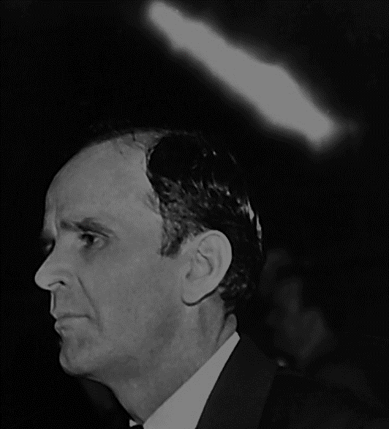
65-0429B The Seed Shall Not Be Heir With The Shuck
Just one Word misinterpreted, caused every sickness, death, that we’ve ever had. Well, if God, Who is holy, looked down; and caused all this chaos by just slightly misinterpreting one Word, and any little thing against that supreme Word caused all of this chaos;

Slide 5
65-0429B The Seed Shall Not Be Heir With The Shuck
… and the suffering, bleeding and dying of His Own Son, to reconcile this horrible thing back to Him; how are we going to get in anything less than keeping the whole Word?

Slide 6
Why? How much power can be in one single Word?

Slide 7
PROVERBS 11 : 1
. . . a false balance . . .

Slide 8
God’s Leadership is the protective headship in which safety can be found.

Slide 9
In a Godly marriage the man has all authority to establish the home.

Slide 10
Within the headship of that authority the wife has full liberty to have charge of the home.

Slide 11
Hitting the Mark

Slide 12
The Blind

Slide 13
The Right Commission!

Slide 14
Going beyond the commission

Slide 15
What can a minister give you other than God’s Word?

Slide 16
62-1230M Absolute
388 That Something that you just didn’t make believe, you just didn’t imagine, but Something spoke back to you, and then you seen your life change from that time. See, every Word of God, every promise, is punctuated with an “amen,” then you’re holding to the absolute. …

Slide 17
62-1230M Absolute
… Cause, remember, He said, “Heavens and earth will pass away, but My Word shall not fail.”

Slide 18
62-1230M Absolute
389 You haven’t come to that place yet, to where you could say “amen” to every Word, if It was against your creed, It was against your denomination, but you want to come to that place, like Moses, like the
rest of them?

Slide 19
62-1230M Absolute
… They could not do that till they caught that absolute. And you want it in your life this morning, would you just signify the same by just lifting your hands to God?

